Slide 1
PayRoll
@ Dong Enterprise
Jean-Christophe Mignon
Raj Mohapatro
David Spring

Slide 2
Business opportunity
One significant source of inefficiency across nearly all industries in the legacy world is the delay in payments for services rendered to employees and contractors.
Smart contracts can be used to programmatically distribute payments to workers in real-time, which would reduce accounting overhead costs for employers, as well as providing access to earned wages for workers on a more immediate basis in a range of currency or forms.
Additionally, Chainlink Price Feeds can be used to calculate the exact amount of crypto revenue or forex to distribute, maintaining a certain currency value per payout.
The new way of handling payroll, ......
Give ownership to your employees …….
Notes:
Let your employees define how much they want to earn!

Slide 3
Our Solution>> dApp for Salary Payments
Instant borderless payments
Secure DeFi payments
Flexibility for the employee
Salary transparency (optional)
Lower payroll costs
Notes:
Let your employees define how much they want to earn!

Slide 4
Your Token at the centre
Insurance
Swag
Gym membership
DONG
Token
Annual leave
Salary
IT upgrade
Training credits
Company Shares

Slide 5




Your Employees in the driver seat
Salary
Insurance
Annual leave
IT upgrade
Notes:
Let your employees define how much they want to earn!

Slide 6
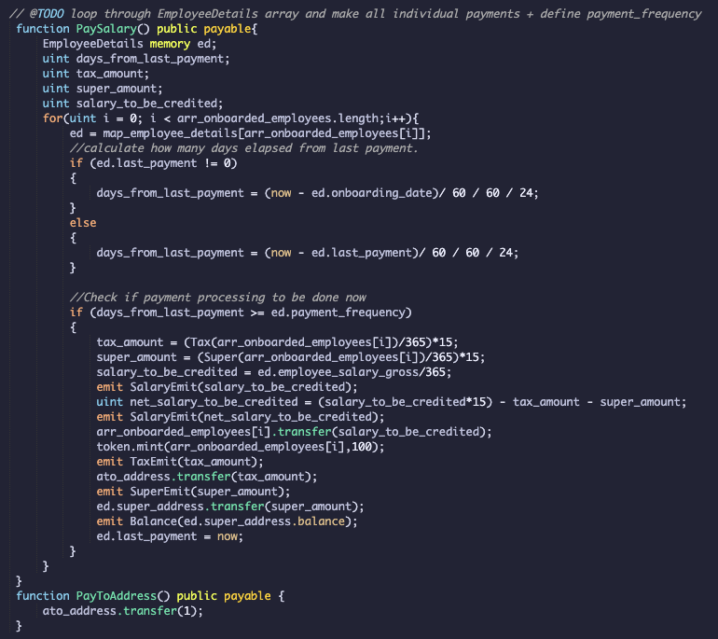
Project Architecture
SALARY PROCESSOR
UI
ONBOARDING
TOKEN MINTING
SCREEN SHOT OF THE EMPLOYEE CONTRACT CODE
Solidity
Java Script/web3
Web3Python
Chainlink Oracle
NIGHTLY PAYMENT SCHEDULER
CURRENCY VALUE

Slide 7
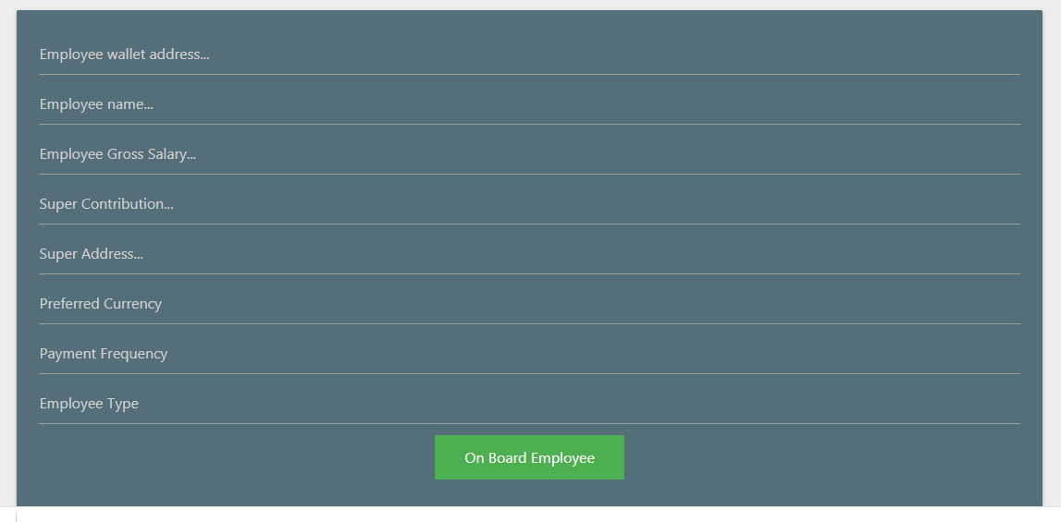
Onboarding

Slide 8
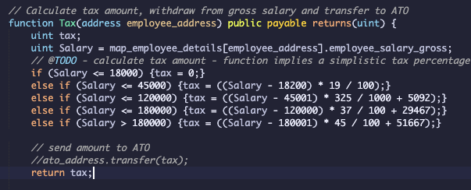
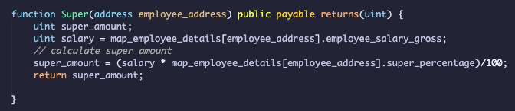
ATO calculator & Super transfer
Notes:
Let your employees define how much they want to earn!

Slide 9
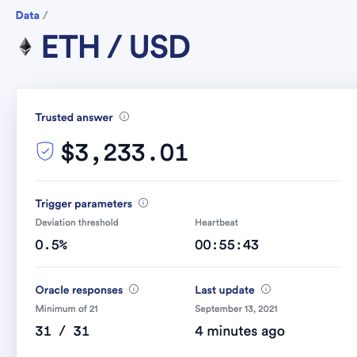
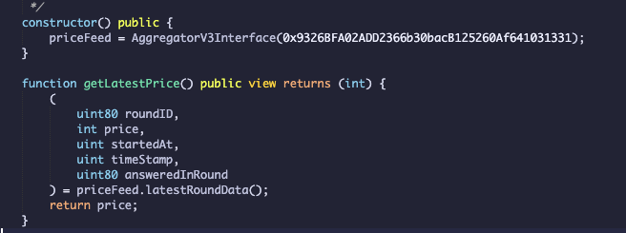

Facilitate stablecoin payments
Java Script
Web3Python

Slide 10
Salary Processor
Notes:
Let your employees define how much they want to earn!

Slide 11
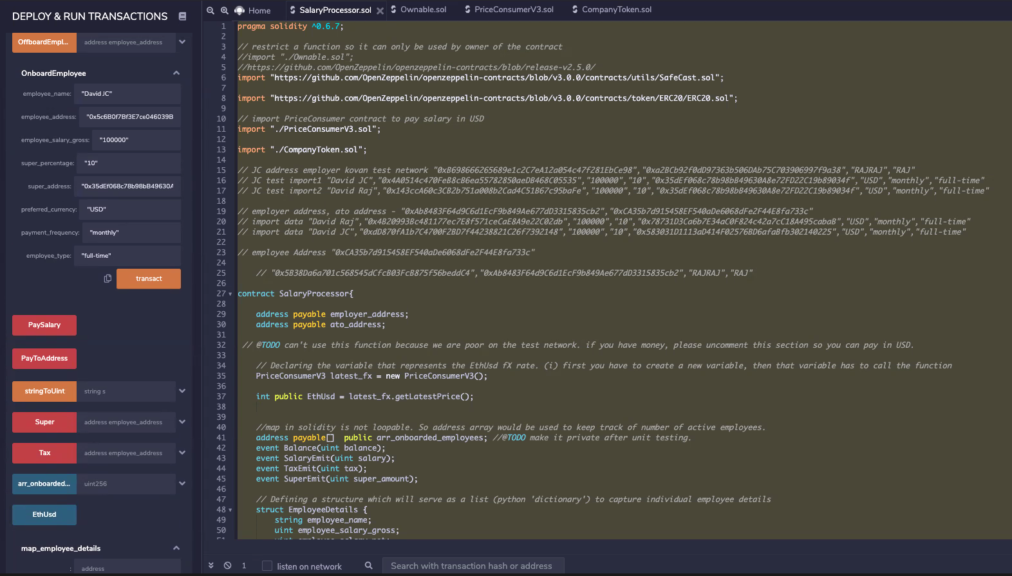
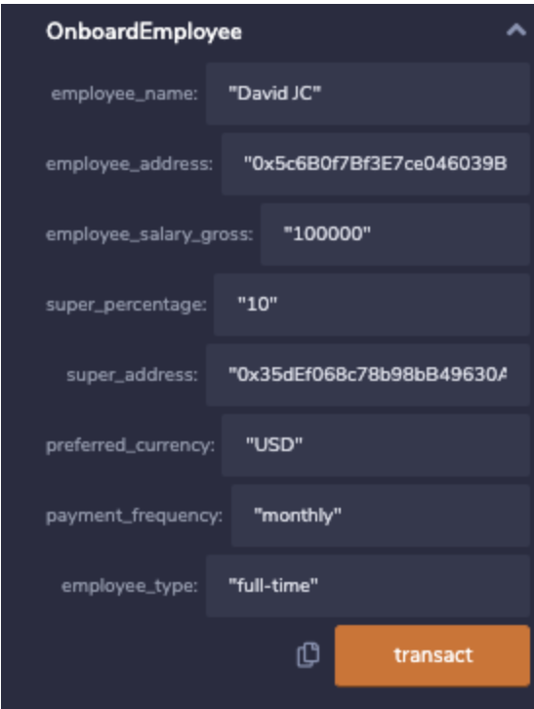
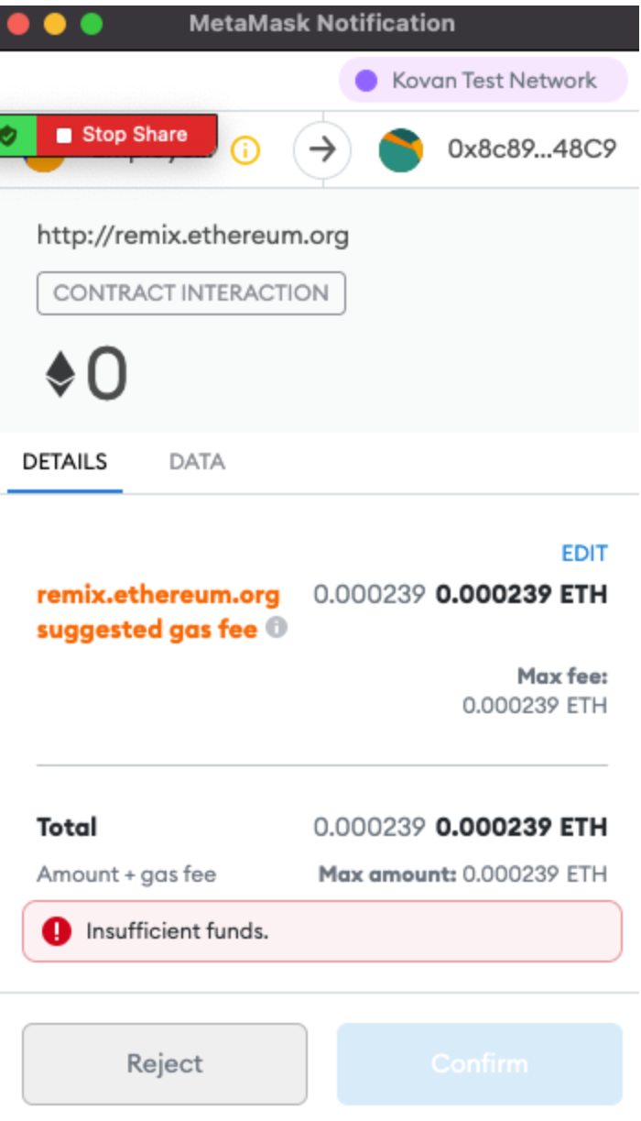
Contract execution

Slide 12
Improvements
Onboarding Bulk upload (CSV)
Bonus calculation feature (Sales Finance)
Analytics - overview of EOFY statements via Python
Python automation for the Salary Processor function
Notes:
CalculateBonus(){}

Slide 13


Q & A
Thank you from the Grand Final Team

